Slide 1
Environmental Injustice:
When the Grass is Actually Greener on the Other Side

Slide 2
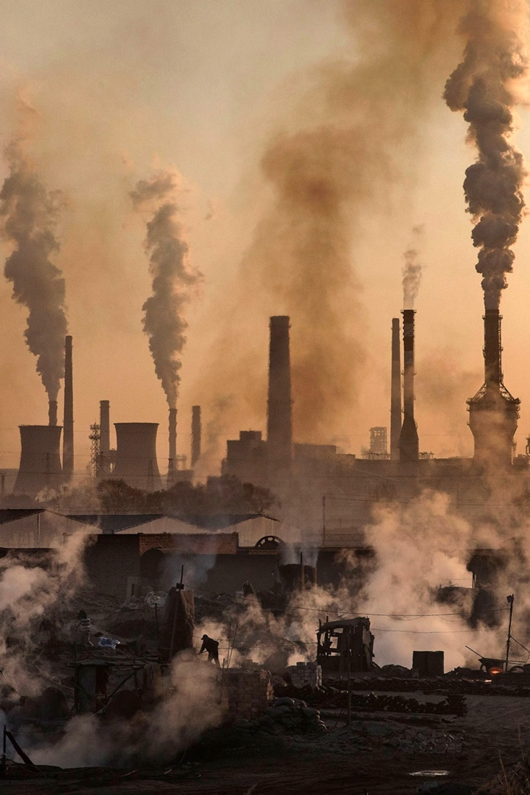
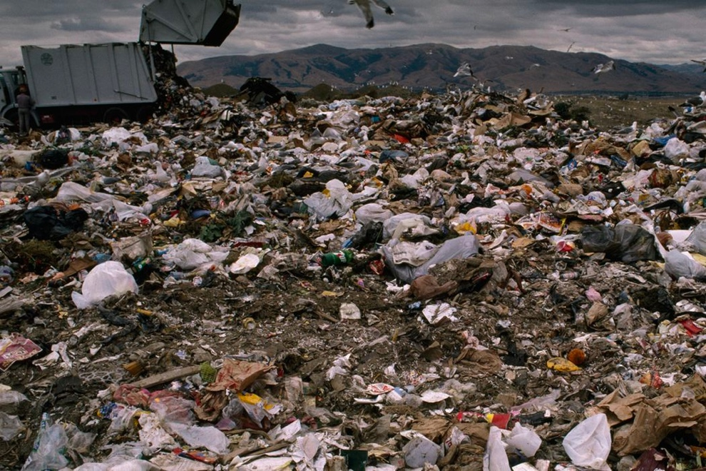
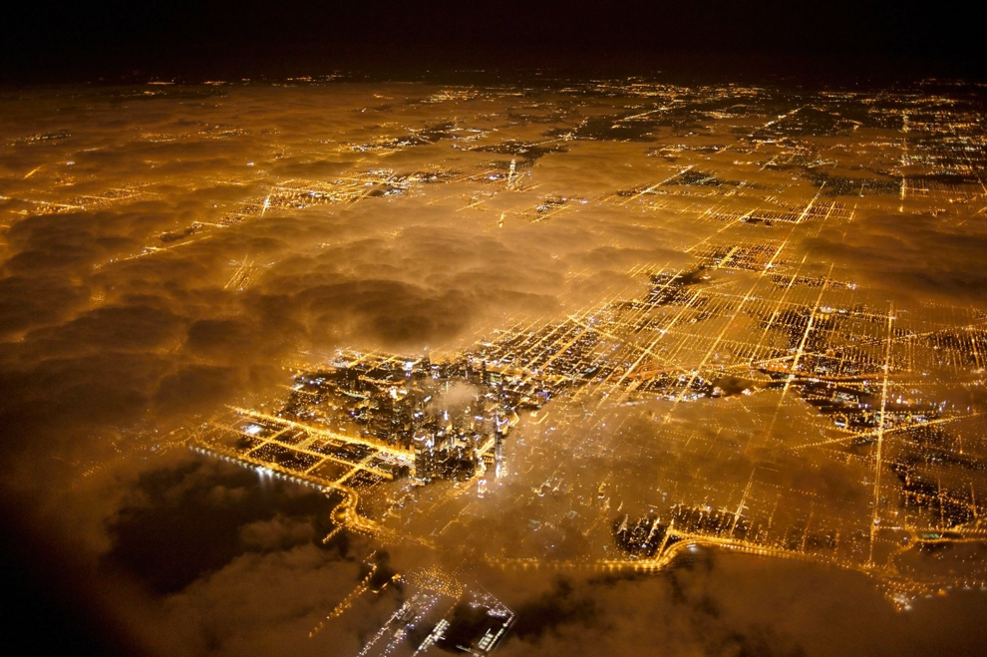
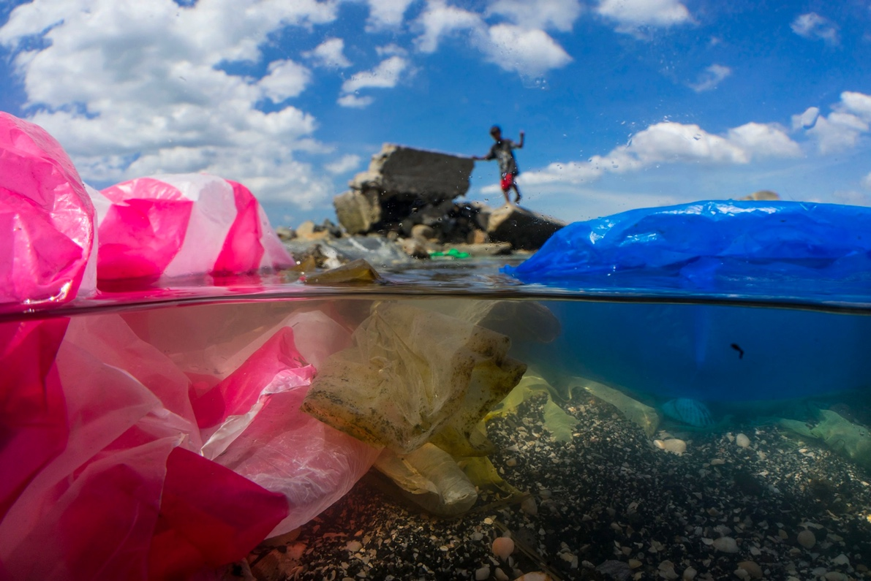
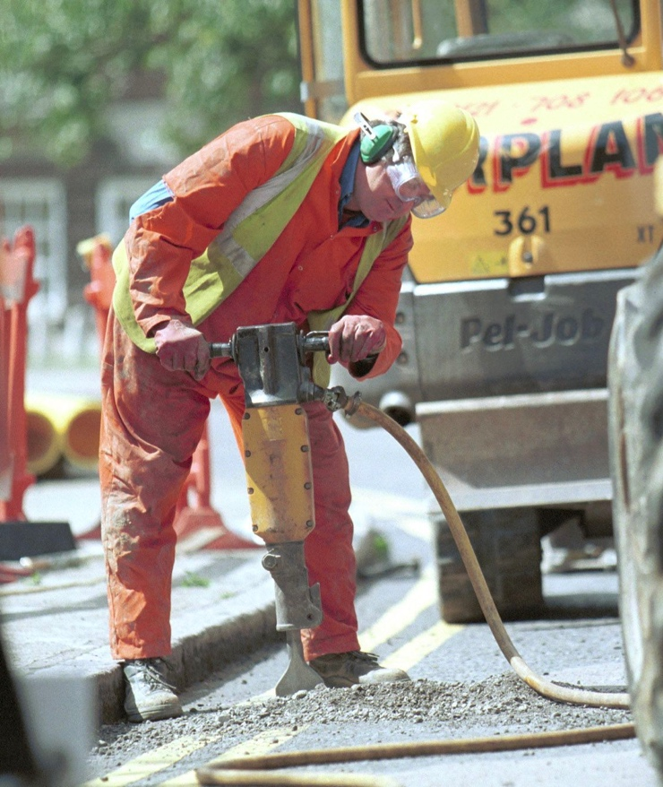
5 Main Types - Air - Water - Soil - Light - Noise
Types of Pollution
Image source: National Geographic
Image source: National Geographic
Image source: National Geographic
Image source: National Geographic
Image source: National Geographic

Slide 3
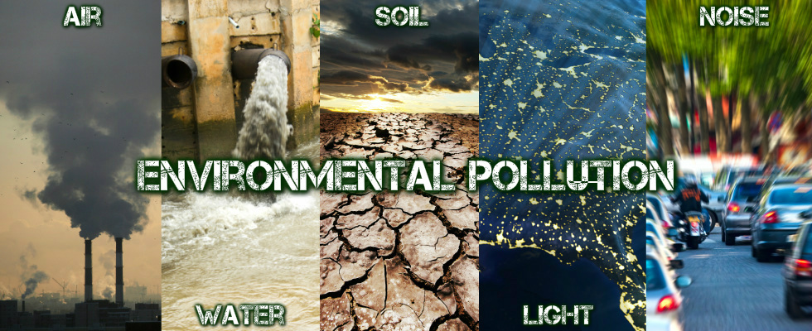
Air Pollution
Water Pollution
Soil Pollution
Light Pollution
Noise Pollution
Similar to water pollution!
Examples:
Mining & drilling
Pesticides & fertilizer
Unmanaged waste
Management of these examples often leads to increased air and water pollution through decomposition and burning methods.
Excessive or misdirected artificial light.
Leads to:
Glare- Excessive brightness & visual discomfort
Clutter- excessive groups of light sources
Light trespass- light extending to an area not intended
Examples:
Traffic noise Ships Sonar devices Oil drills Seismic tests
Leads to:
Hearing loss Stress High blood pressure
Harmful to oceanic life utilizing echolocation
Examples:
Burning fossil fuels
Cars and Factories
Volcanic ash
Examples:
Oil & natural gas leak
Factory runoff
Acid mine drainage Improper waste dump
Mistreated sewage
Fertilizer runoff
Excess garbage
Leads to:
Acid rain
Greenhouse gases
Ocean acidification
Eye burn
Difficulty breathing
Lung cancer
Leads to:
Bacterial infection
Affected food sources
Harmful algal blooms
Oceanic dead zones
Notes:
https://www.nationalgeographic.org/encyclopedia/pollution/
https://www.nationalgeographic.org/article/light-pollution/#:~:text=There%20are%20three%20other%20kinds,for%20example%2C%20when%20driving).
https://www.nationalgeographic.org/encyclopedia/noise-pollution/

Slide 4
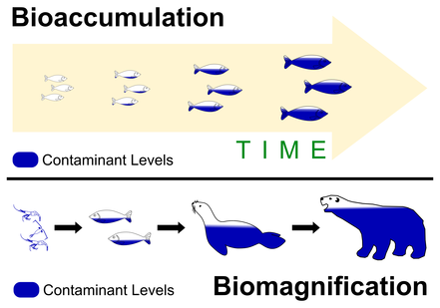
the accumulation over time of a substance and especially a contaminant (such as a pesticide or heavy metal) in a living organism
Bioaccumulation:
Image from: Catalina Island Marine Institute

Slide 5
the concentration of toxins in an organism as a result of its ingestion of other organisms where toxins are more widely dispersed
Biomagnification:
Image from: Catalina Island Marine Institute

Slide 6
Now investigate how the effect may vary across variable (e.g. socioeconomic status and race)?
Today’s Activity:

Slide 7

25 minutes: Complete your student handout

Slide 8
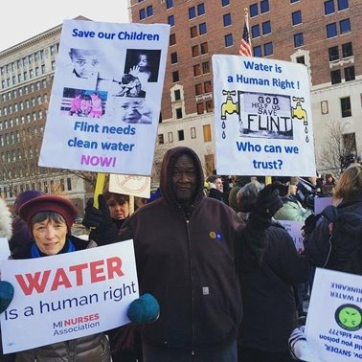
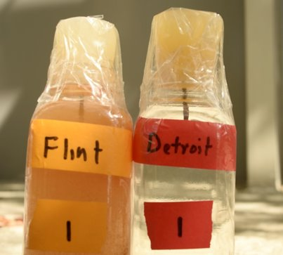
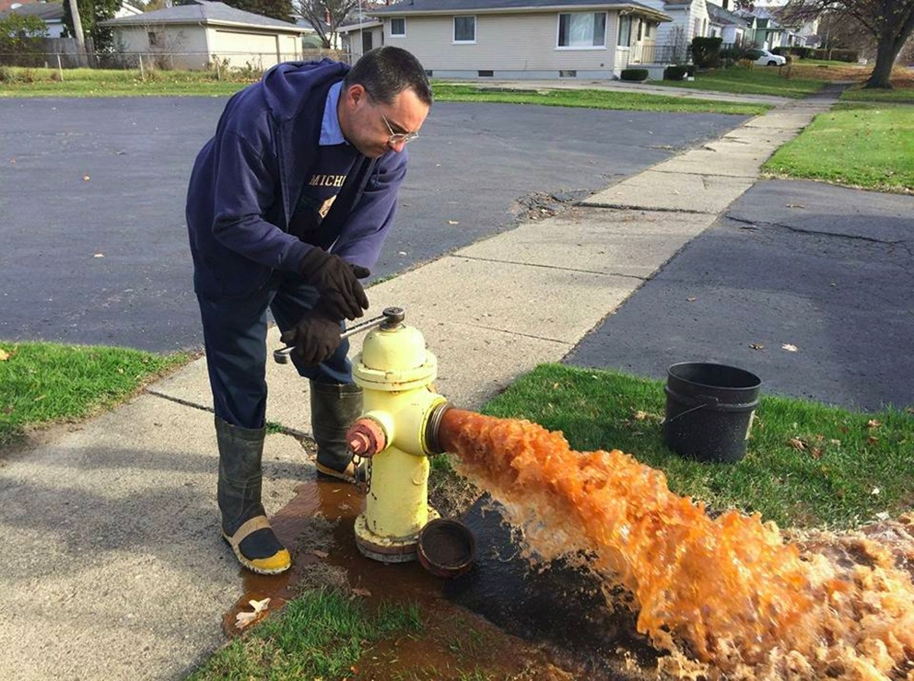
Flint Water Crisis
Nobody: Casualties of America's War on the Vulnerable, from Ferguson to Flint and Beyond
Marc Lammont Hill
Image from: CNN
The Flint water crisis is one of the most apparent and extreme examples.....
2016: Criminal investigation led to 15 people being arrested for causing or contributing to the crisis
Notes:
The average income for Flint MI is 14,527 dollars a year. About half the average for the united states. This is an economically disadvantaged community. This started in 2014 when the water source was changed from Detroit treated city water to water coming from the Flint river. Officials failed to apply corrosion inhibitors to the water, and lead from pipes then contaminated the water.
Over 100,000 residents were exposed to high lead levels before they were aware there was an issue. While multiple government officials resigned due to the negligence, that was not the end of the issue. The pipes were still affected. So even after switching back to the public water supply, the water was contaminated. Despite a high level of complaints and reports of sickness from local residents — a majority of which were low-income people of color — city management failed to adequately respond and treated the matter with indifference.
Now in 2021, there are still major questions about the water quality in Flint. These choices were made for economic gain, and shortcuts were taken in the process. The slow fix of the pipes were also apparent. All of these issues are directly related to the people that were being supplied water. While the Obama administration offered aid, some damage can’t be undone. And this is a clear example.

Slide 9
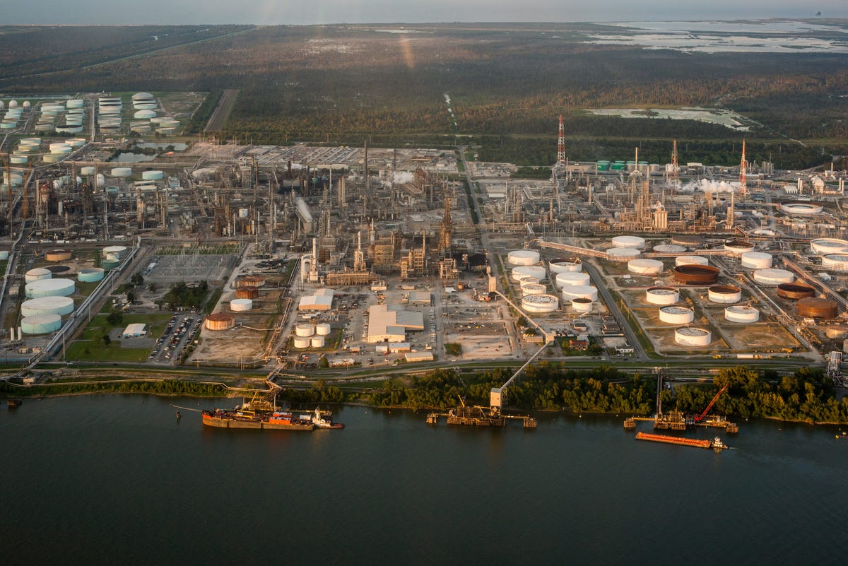
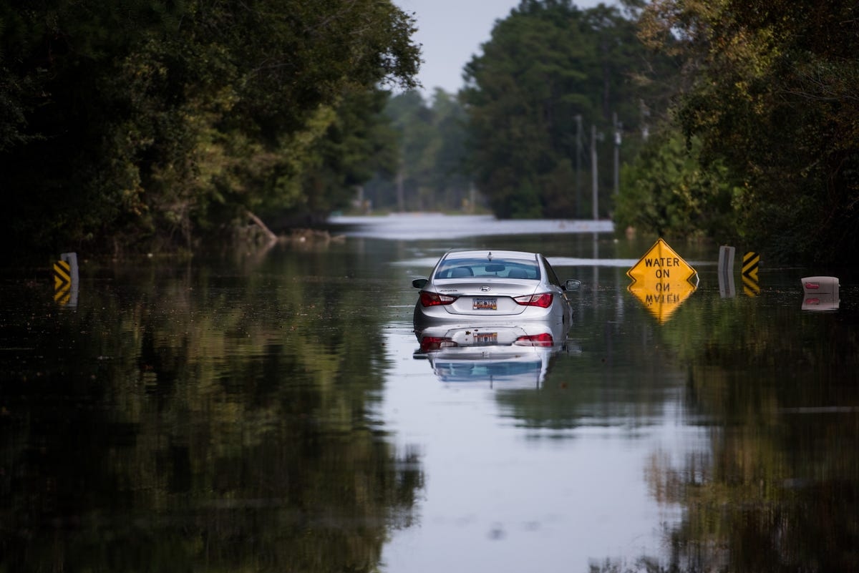
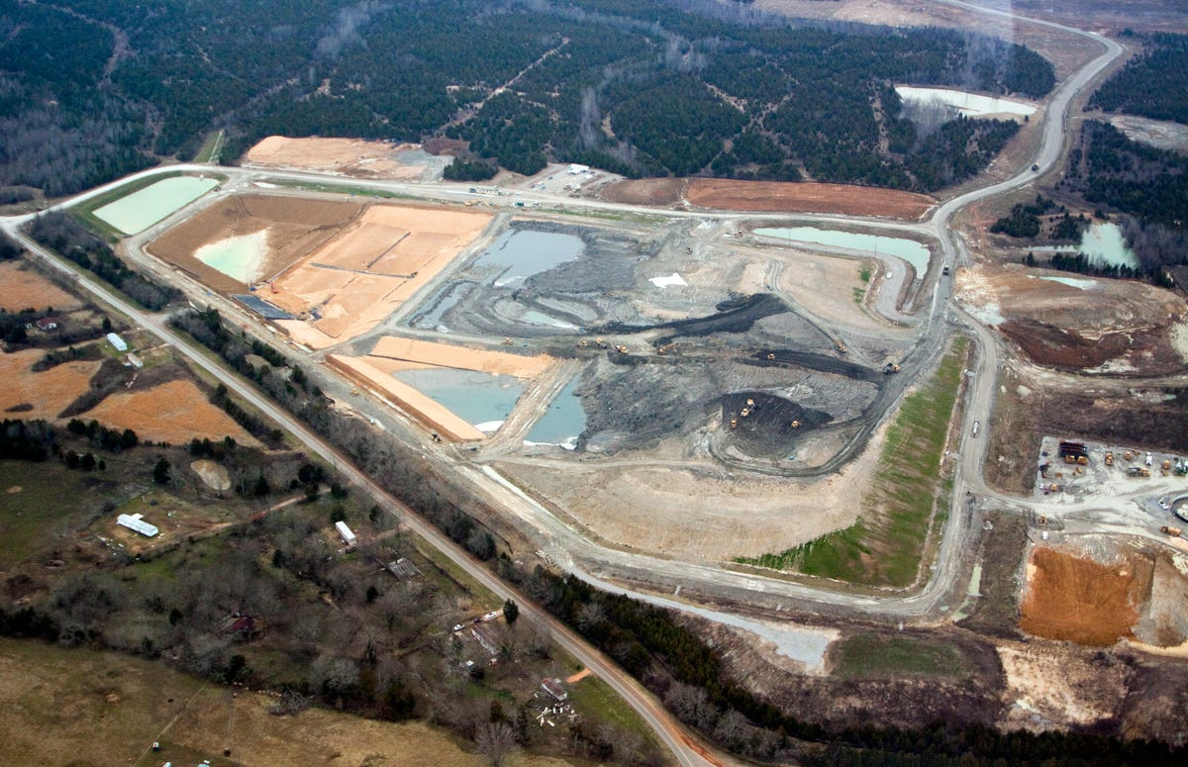
Cancer Alley: LA Cheraw, SC Uniontown, AL
Cancer Alley, LA
Cheraw, SC
Uniontown, AL
An estimated 70% of contaminated waste sites are located in low- income neighborhoods, and an upwards of 2 million Americans live within a mile of sites that are vulnerable to flooding — the majority of which are in Black and brown communities.
Notes:
That is not an isolated case though. Here are a few more examples.
Cancer Alley is an 85-mile stretch of land along the Mississippi River between New Orleans and Baton Rouge that's lined with oil refineries and petrochemical plants. The location got its sinister name "Cancer Alley" because residents of the area are 50 times more likely to develop cancer than the average American — and those who live there are predominantly Black.
In 2008, over a billion tons of deadly coal ash spilled into the Emory River Channel in Kingston, Tennessee. The catastrophe left workers who cleaned the mess to suffer from brain cancer, lung cancer, and leukemia.
Then, in 2010, the Tennessee Valley Authority transported 4 million cubic yards of coal ash from the spill into Uniontown, Alabama, a predominantly low-income Black community.
Under the Comprehensive Environmental Response, Compensation, and Liability Act (CERCLA), the EPA deemed the coal ash nonhazardous in Uniontown, and therefore provided the community with no protection against the highly dangerous substance.
Up until the 1970's, cancer-causing PCBs, or harmful chemicals, were dumped in a creek in Cheraw, South Carolina by Burlington Industries.
Decades later, the effects are still being felt.
In 2018, five families were displaced from their homes after Hurricane Florence hit and triggered remains of the chemicals to wash up from the creek into houses and yards. Additionally, the toxic waste was found within the soil of a local playground, which had to be closed down and barred from use.

Slide 10
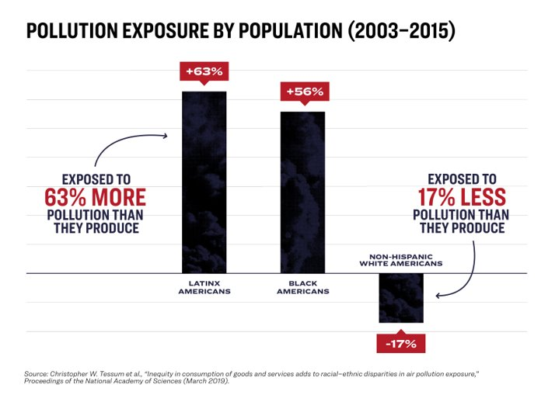
Add graphics about pollution effects
Notes:
Top: This graph depicts the amount of pollution that you are exposed to compared to the amount that you produce. On average, while americans are exposed to 17% less pollution than they produce. But Latinx Americans are exposed to 63% more, and black American's are exposed to 56% more than they produce.

Slide 11
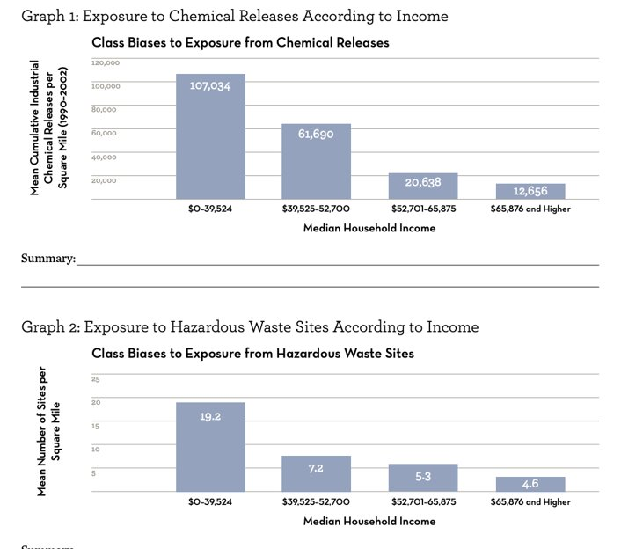
Add graphics about pollution effects
Notes:
Something to consider is that race is often conflated with economic class. Poorer communities tend to be disproportionally occupied by people of color. Now what is important to remember is that this is mostly due to the chronic repression seen in our economic practices, not because those communities have less potential in any way.
On these two graphs, you can see chemical release exposure by household income. It is a fairly clear relationship. The less money you make, the more chemical releases you are exposed to.
On the bottom, you can see that the less money you make, the more sites for chemical waste release there are.
So we are targeting poor areas to build chemical release sites. And as a result, the occupant of those areas are exposed to much higher levels of chemical waste.

Slide 12
Thoughts?

